Slide 1
Chapter-13
Interfacing Data Converters
13.1 DIGITAL-TO-ANALOG (D/A) CONVERTERS
Digital-to-Analog converters can be classified in three categories:
current output: provides current as output signal.
voltage output: internally converts current signal into voltage signal.
multiplying type: output current or voltage is product of input current or voltage.
Voltage output is slower than current output because of the delay in converting the current signal into voltage signal. However, in many applications, it is necessary to convert current into voltage by using an external operational amplifier.

Slide 2
13.1.1 Basic Concepts
Figure 13.1(a) shows a block diagram of a 3-bit D/A converter. If the input ranges from 0 to 1 V, it can be divided into eight equal parts (1/8 V); each successive is 1/8 V higher than the previous combination, as shown in Figure 13.1(b).
The following points can be summarized from the graph:
If a converter has n input lines, it can have 2^{n} input combinations.
If the full-scale analog voltage is 1 V, the smallest unit or the LSB (001₂) is equivalent to 1/2^{n} of 1 V. This is defined as resolution.
The MSB represents half of the full-scale value. In this example, the MSB (100₂)=1/2 V.
For the maximum input signal (111₂), the output signal is equal to the value of the full scale input signal minus the value of the 1 LSB input signal. In this example, the maximum input signal (111₂) represents 7/8 V.
Example 13.1: Calculate the values of the LSB, MSB, and full-scale output for an 8-bit DAC for the 0 to 10 V range.

Slide 3
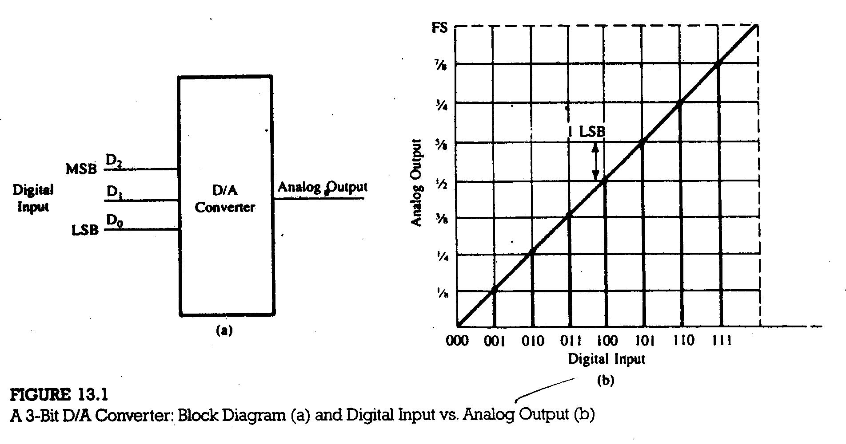

Slide 4
Solution:
1. LSB = 1/2⁸ = 1/256
For 10 V, LSB = 10 V/256 = 39 mV
2. MSB = 1/2 full scale = 5V
3. Full-Scale Output = (Full-Scale Value – 1 LSB)
= 10V – 0.039 V
= 9.961 V
13.1.2 D/A Converter Circuits
The input resistors R₁, R₂, and R₃ are selected in binary weighted proportion; each has double the value of the previous resistor. If all three inputs are 1 V, the total output current is
I_{o} = I_{T} = I₁ + I₂ + I₃
= V_{in}/R₁ + V_{in}/R₂ + V_{in}/R₃
= V_{in}/1k(1/2 + 1/4 +1/8)
= 0.875 mA

Slide 5
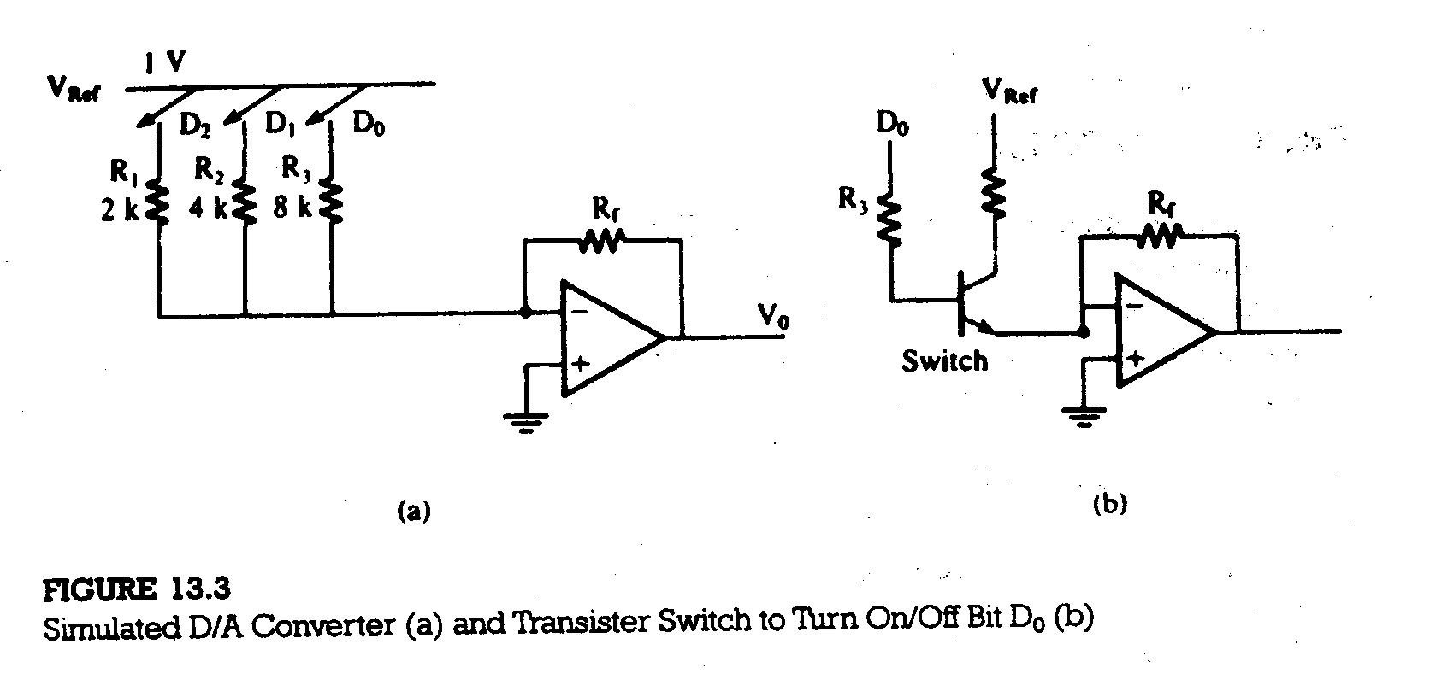

Slide 6
The voltage output is
V_{o} = - R_{f}I_{T}
= - (1 k) (0.875 mA)
= |7/8|
This example shows that for the input = 111₂ , the output is equal to either 7/8 mA or 7/8 V, representing the D/A conversion process.
Now the output current I_{o} can be generalized for any number of bits as
I_{o} = V_{Ref} /R (A₁/2 + A₂/4 + - - - - - + A_{n}/2^{n})
The following points can be inferred from the above example:
1. A D/A converter circuit requires three elements: resistor network with
appropriate weighting, switches, and a reference source.
2. The output can be a currant signal or converted into a voltage signal using
an operational amplifier.
3. The time required for conversion, called settling time, is dependent on the
response of the switches and output amplifier (for a voltage output DAC).

Slide 7
13.1.3 Illustration: Interfacing an 8-Bit D/A Converter
PROBLEM SATEMENT
1. Design an output port with the address FFH to interface the 1408 D/A
converter that is calibrated for a 0 to 10 V range; refer to Figure 13.5(a).
2. Write a program to generate a continuous ramp waveform.
3. Explain the operation of the 1408 in Figure 13.5(b) , which is calibrated for a
bipolar range ±5V. Calculate the output V_{O} if the input is 10000000₂ .
HARDWARE DESCRIPTION
The total reference current source is determined by the resistor R₁₄ and the voltage V_{Ref} . The resistor R₁₅ is generally equal to R₁₄ to match the input impedance of the reference source. The output I_{O} is calculated as follows:
I_{o} = V_{Ref} /R₁₄ (A₁/2 + A₂/4 + A₃/8 + A₄/16 + A₅/32 + A₆/64 + A₇/128 + A₈/256)
Where inputs A₁ through A₈ = 0 or 1.

Slide 8
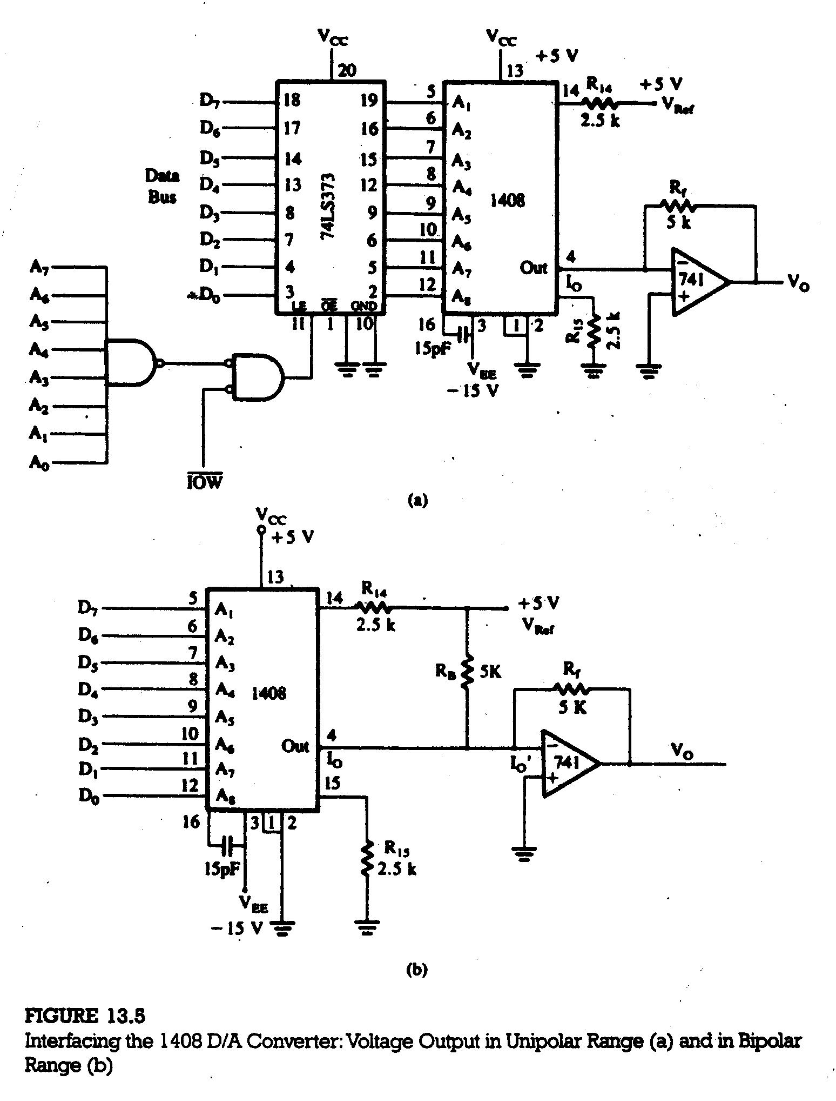

Slide 9
This formula is an application of the generalized formula for the current I_{o}. For full scale input (D₇ through D_{o} = 1).
I_{o} = 5 V /2.5 k (1/2 + 1/4 + 1/8 + 1/16 + 1/32 + 1/64 + 1/128 + 1/256)
= 2 mA (255/256)
= 1.992 mA.
The output is 1 LSB less than full-scale reference source of 2 mA. The output voltage V_{o} for the full-scale input is
= 2 mA (255/256) x 5 k
= 9.961 V

Slide 10
PROGRAM
To generate a continuous waveform, the instructions are as follows:
MVI A, 00H ; First input 00H for DAC
DTOA: OUT FFH ; Output to DAC
MVI B, COUNT ; COUNT for delay
DELAY: DCR B
JNZ DELAY
INR A ; Next input for DAC
JMP DTOA
Program Description:
The program outputs 00H to FFH as the digital inputs for DAC. The analog output of the DAC starts at 0 V and increases up to 10 V (approximately) as a ramp. When the accumulator contents go to 0, the next cycle begins; thus the ramp signal is generated continuously and that can displayed on oscilloscope.
The delay in the program is necessary for two reasons:
1. The time needed for a microprocessor to execute an output loop is likely to
be less than the settling time of the DAC.
2. The slope of the ramp can be varied by changing the delay.

Slide 11
OPERATING THE D/A CONVERTER IN A BIPOLAR RANGE
The 1408 in Figure 13.5(b) is calibrated for the range from -5 V to +5 V by adding the resistor R_{B} (5.0 k) between the reference voltage V_{Ref} and the output pin. The resistor R_{B} supplies 1 mA (V_{Ref} /R_{B}) current to the opposite direction of the current generated by the input signal. Therefore, the output current for the bipolar operation I_{o} is
I_{o}´ = I_{o} - V_{Ref} /R_{B}
= V_{Ref} /R₁₄ (A₁/2 + A₂/4 + A₃/8 + A₄/16 + A₅/32 + A₆/64 + A₇/128 + A₈/256)- V_{Ref} /R_{B}
When the input signal is equal to zero, the output V_{o} is
V_{o} = I_{o}´ R_{f}
= (I_{o} - V_{Ref} /R_{B}) R_{f}
= (0 – 5 V/5k) (5k) (I_{o} = 0 for input = 0)
= - 5V

Slide 12
When the input = 1000 0000, the output V_{o} is
V_{o} = (I_{o} - V_{Ref} /R_{B}) R_{f}
= (V_{Ref} /R₁₄ x A₁/2 - V_{Ref} /R_{B}) R_{f} (A₂ – A₈ = 0)
= ( 5 V/2.5 k x 1/2 - 5 V/5 k)5k
= (1 mA – 1 mA)5 k
= 0
13.2 ANALOG-TO-DIGITAL CONVERTERS
The A/D conversion is a quantization process whereby an analog signal is represented by equivalent binary states; this is opposite to the D/A conversion process. Analog-to-Digital converters can be classified in two general groups based on the conversion technique:
Successive-approximation A/D converter: used in instrumentation.
Integration-type A/D converter: used in digital meters, monitoring systems.

Slide 13
13.2.1 Basic Concepts
Figure 13.8(a) shows a block diagram of a 3-bit A/D converter. Figure 13.8(b) shows the graph of the analog input voltage (0 to 1 V) and the corresponding digital output signal. The resolution of the converter is 1/8 V.
13.2.1 Successive-Approximation A/D Converter
Figure 13.9(a) shows the block diagram of a successive approximation A/D converter includes three major elements: the D/A converter, the successive approximation register (SAR), and the comparator. The conversion technique involves the output of the D/A converter V_{o} with the analog input signal V_{in}. The digital input to the DAC is generated using the successive-approximation method (explain below). When the DAC output matches the analog signal, the input to the DAC is equivalent digital signal.
In the case of a 4-bit A/D converter, bit D₃ is turned on first and the output of the DAC is compared with an analog signal. If the comparator changes the state, indicating that the output generated by D₃ is larger than the analog signal, bit D₃ is turned off in the SAR and bit D₂ is turned on. The process continues until the input reaches bit D₀.

Slide 14
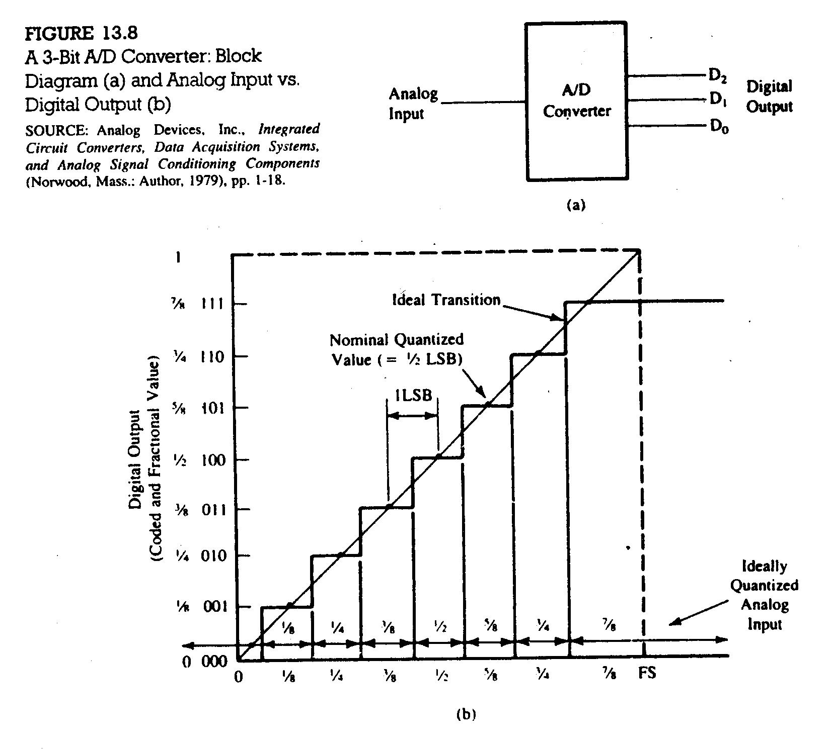

Slide 15
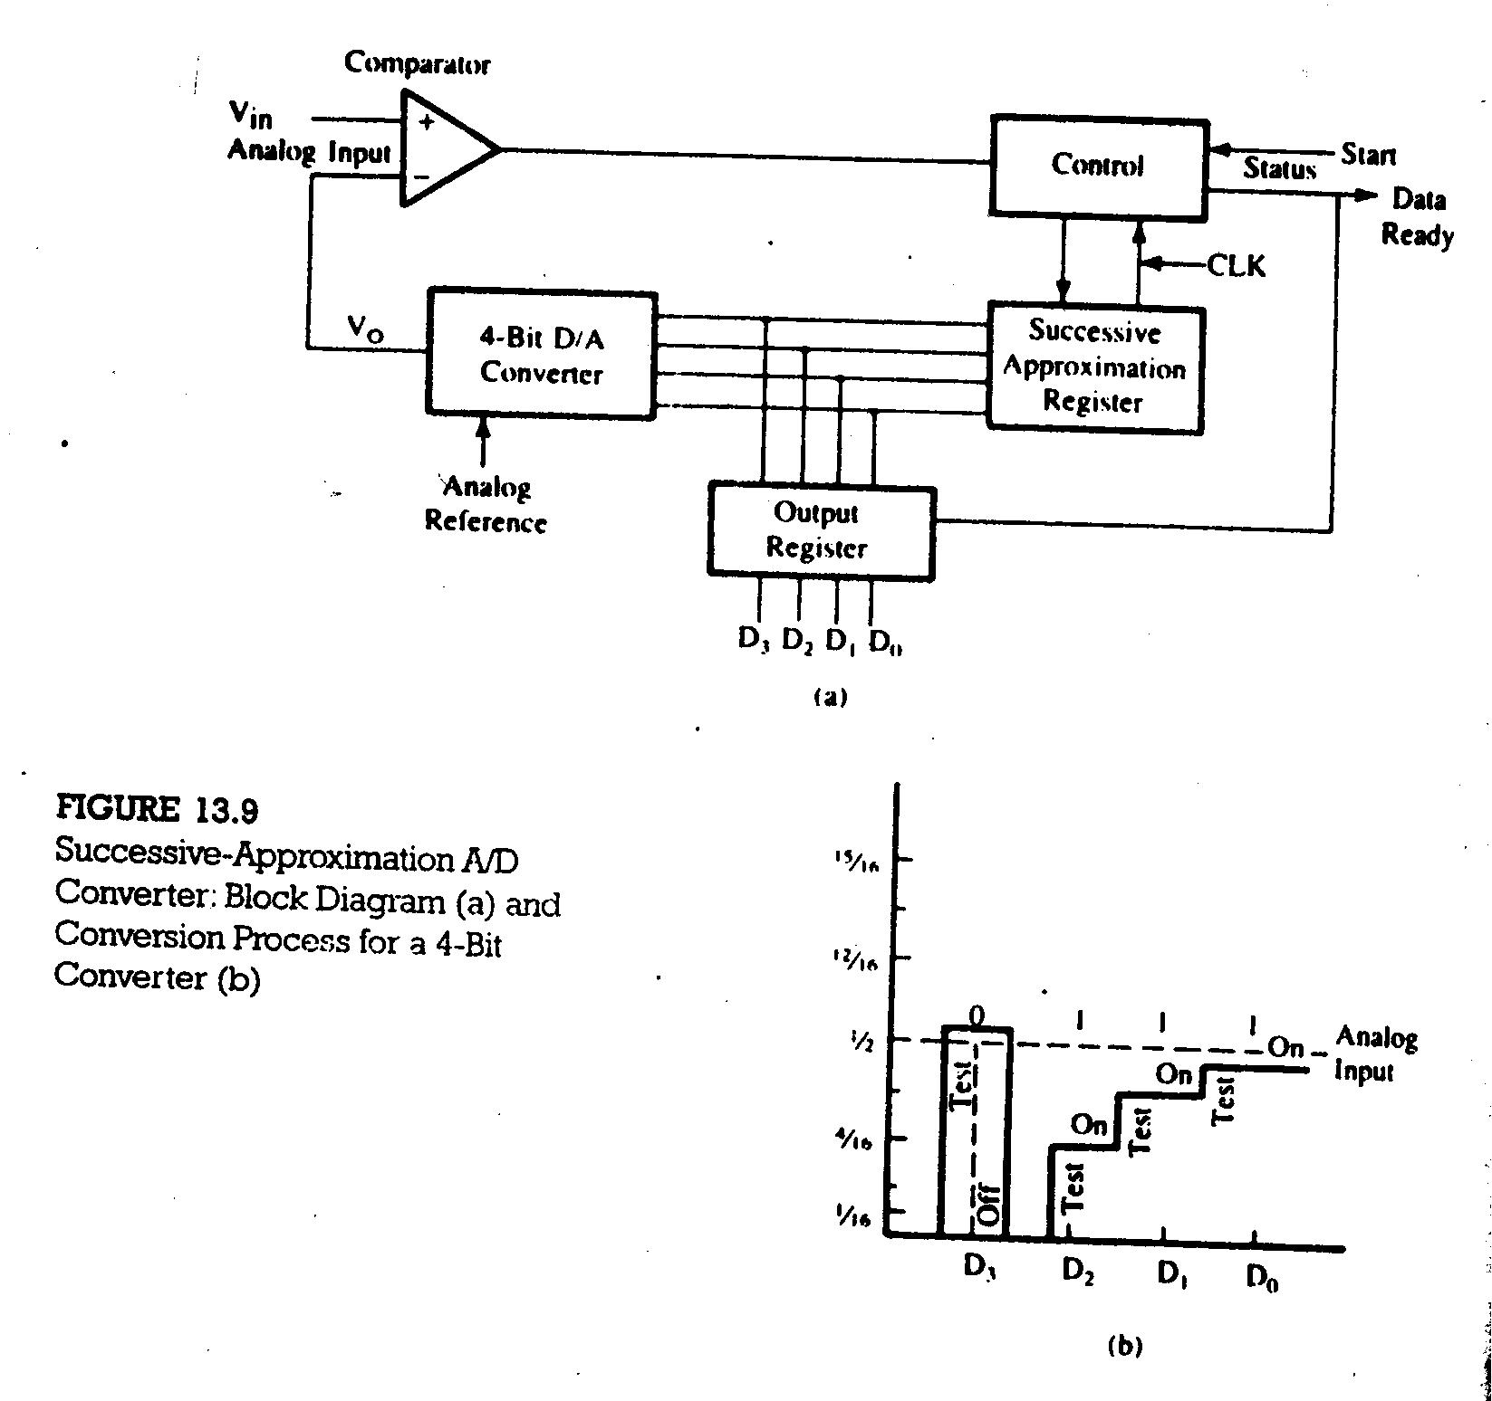

Slide 16
Figure 13.9(b) illustrates a 4-bit conversion process. When bit D₃ is turned on, the output exceeds the analog signal and therefore, D₃ is turned off. When the next three successive bits are turned on, the output becomes approximately equal to the analog signal.
13.2.1 Interfacing 8-Bit A/D Converters
INTERFACING AN 8-Bit A/D CONVERTER USING STATUS CHECK
Figure 13.11 shows a schematic of interfacing a typical A/D converter using status check.
PROGRAM
OUT 82H
TEST: IN 80H
RAR
JC TEST
IN 81H
RET

Slide 17
